Slide 1
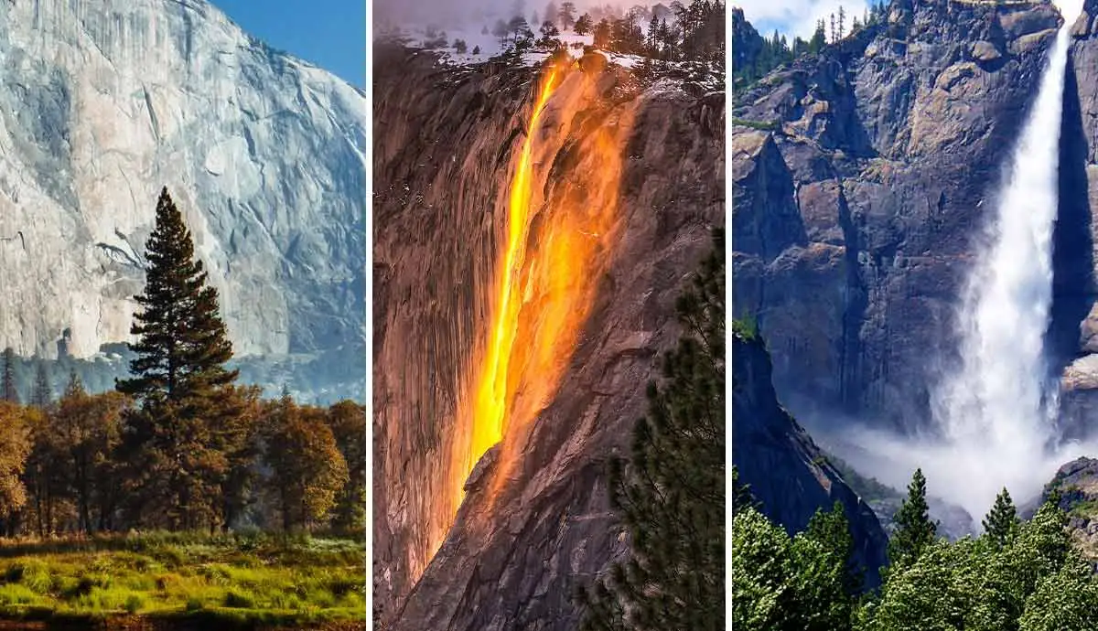
National Park Service:
America’s great outdoors
Andrew Matsuura and Ashley Nguyen

Slide 2
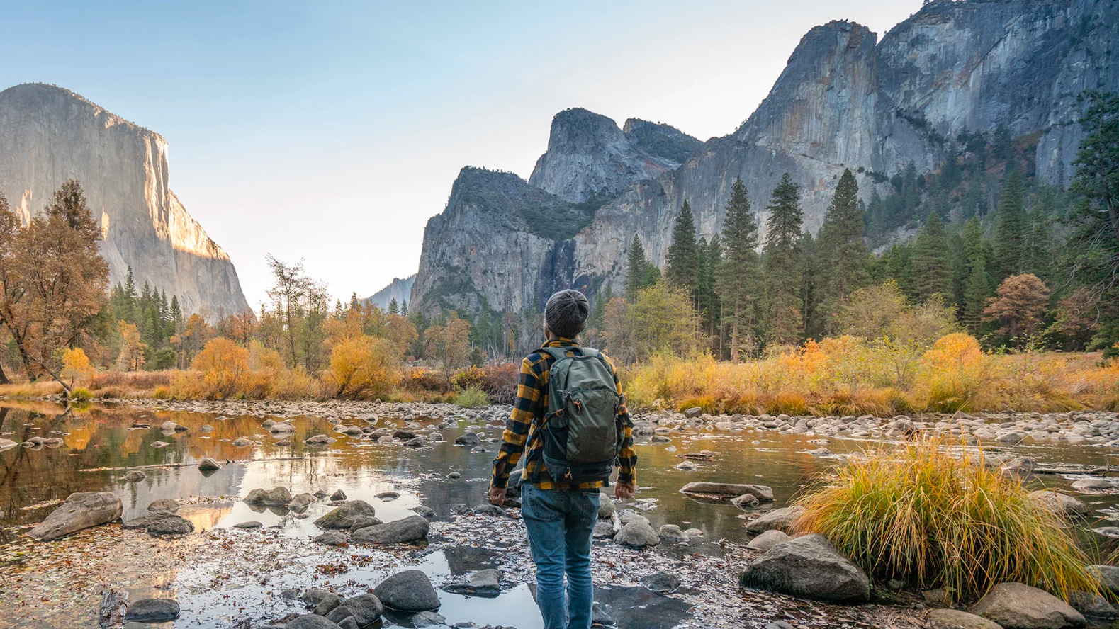
COVID’s impact
Has visitation increased during the COVID-19 Pandemic?

Slide 3
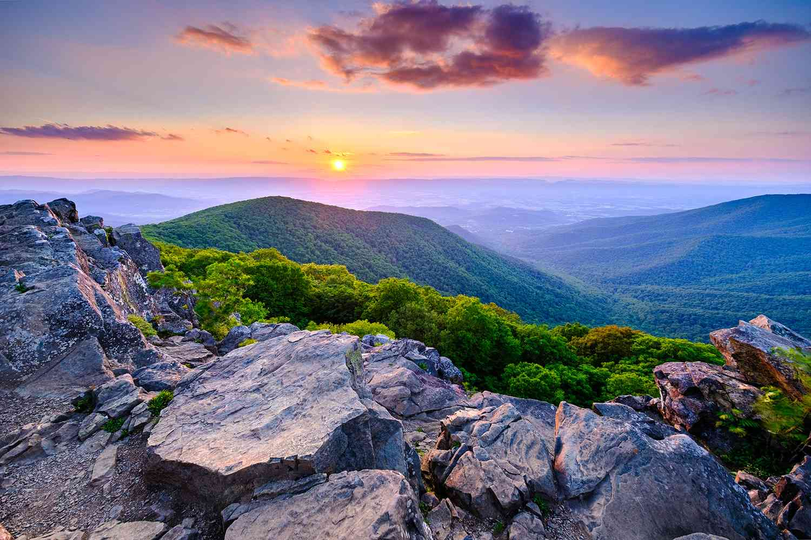
Visitor Spending
How much do the national parks impact the economy?

Slide 4
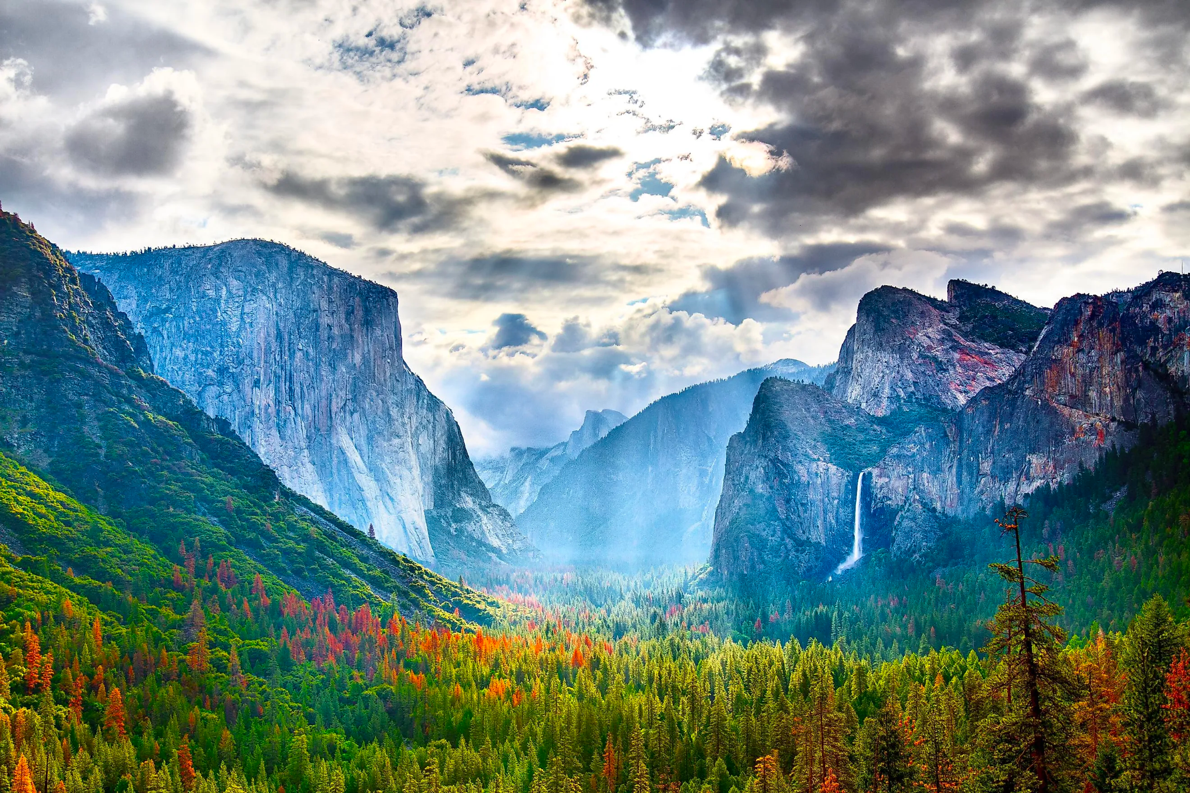
Best Season
What is the best season to visit a park?

Slide 5
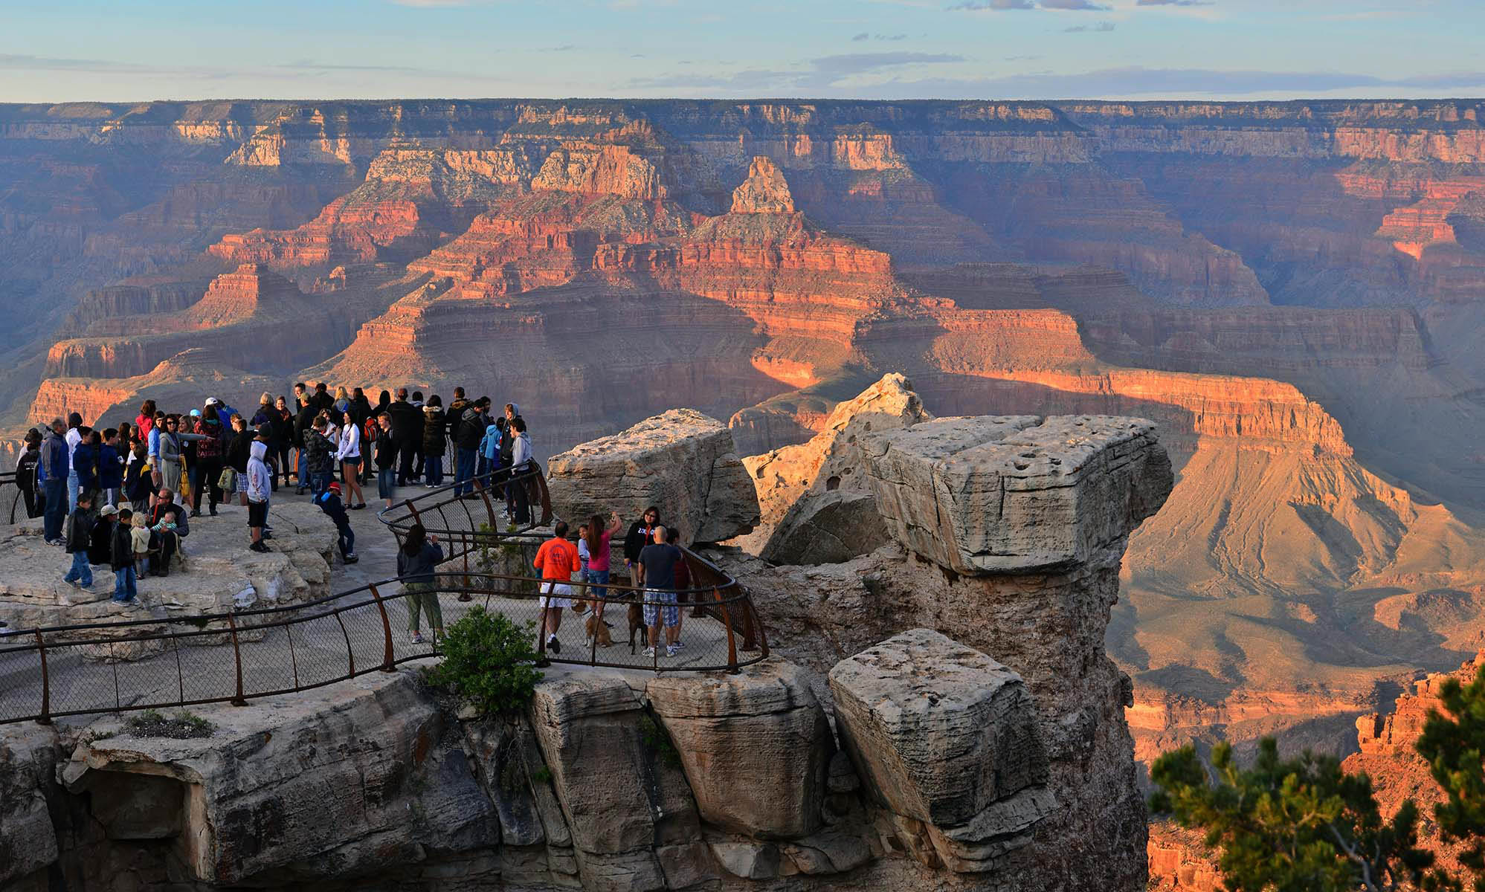
Where are the parks located
What is the best national park to visit based on your location?

Slide 6
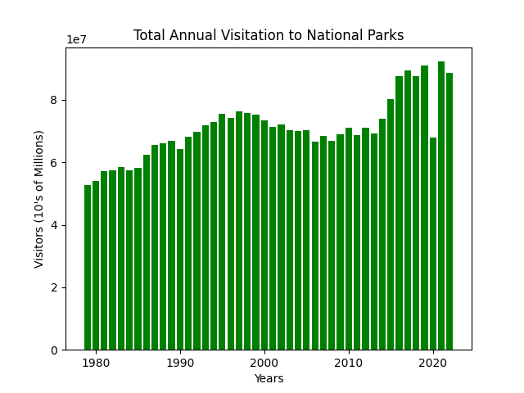
Annual Visitation
^{Steady until 2015}
Large increase in the last 5-10 years
^{2020 outlier year}

Slide 7
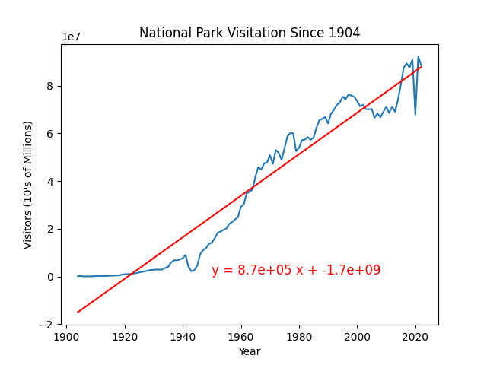
Visitation trends
870,000 new visitors annually
Strong upward correlation
Is it sustainable?

Slide 8
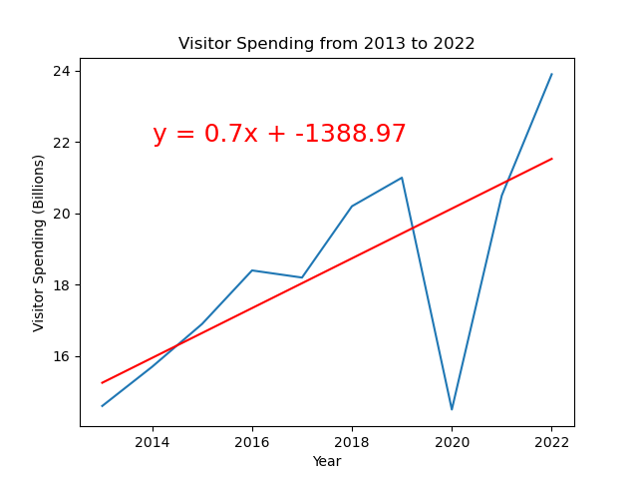
Annual Funding From Visitations
Average increase $700 million every year
Slight decrease in 2017
Significant decrease in 2020
What could be the reason?

Slide 9
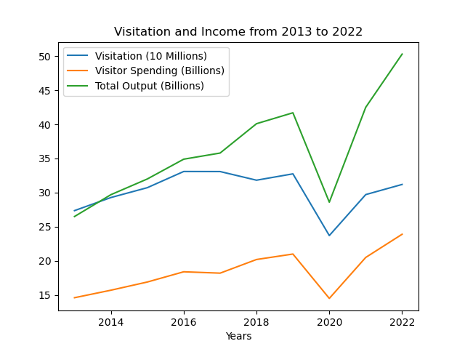
Economic Output
Visitation and visitor Spending are similar
Large dip in 2020
Significant increase economic output 2022

Slide 10
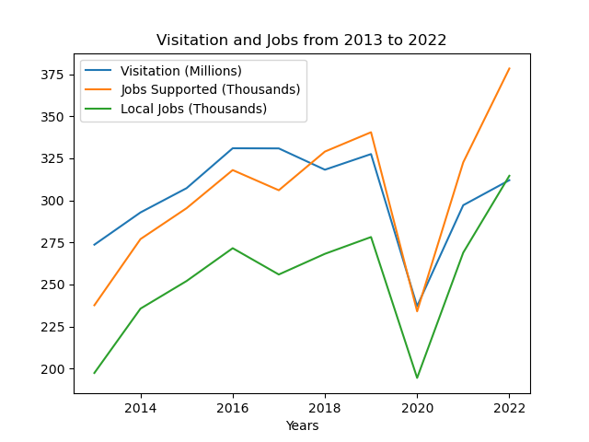
Job Trends
More visitation requires more upkeep
Slight decrease of jobs 2017
Large increase of jobs after 2021

Slide 11
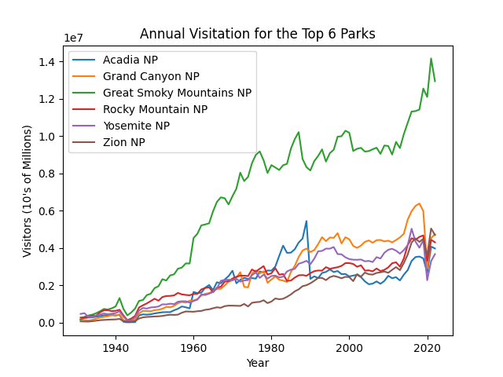
Top 6 Parks
Consistent growth
1989 dip?
Great Smoky mountains very popular

Slide 12
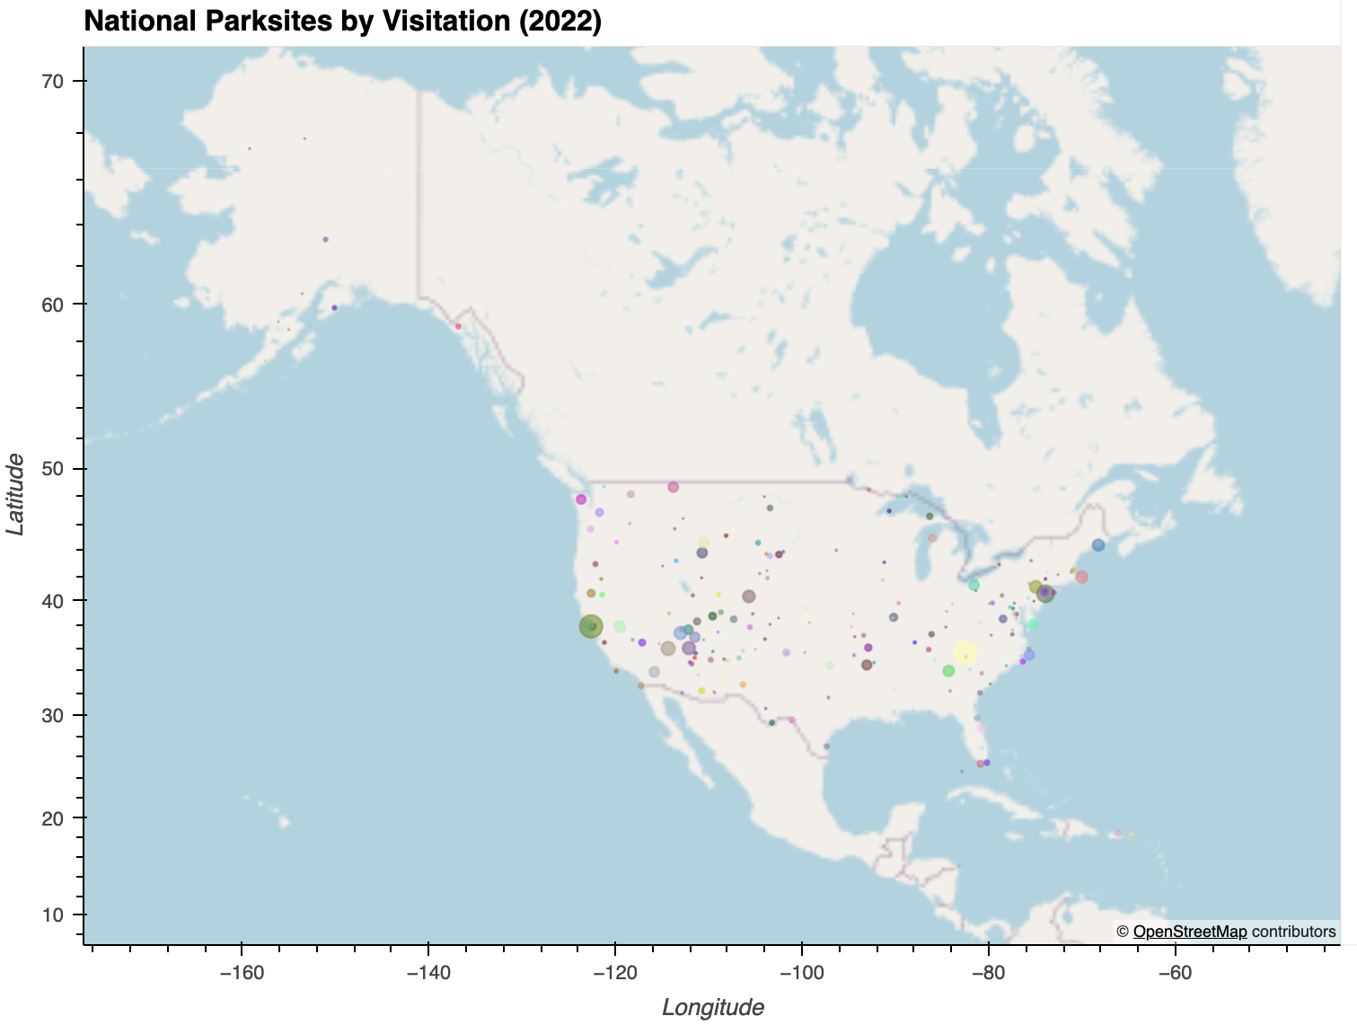
All National Park Sites
Less visitation in Alaska and Hawaii
More park locations and visitors in contiguous US

Slide 13
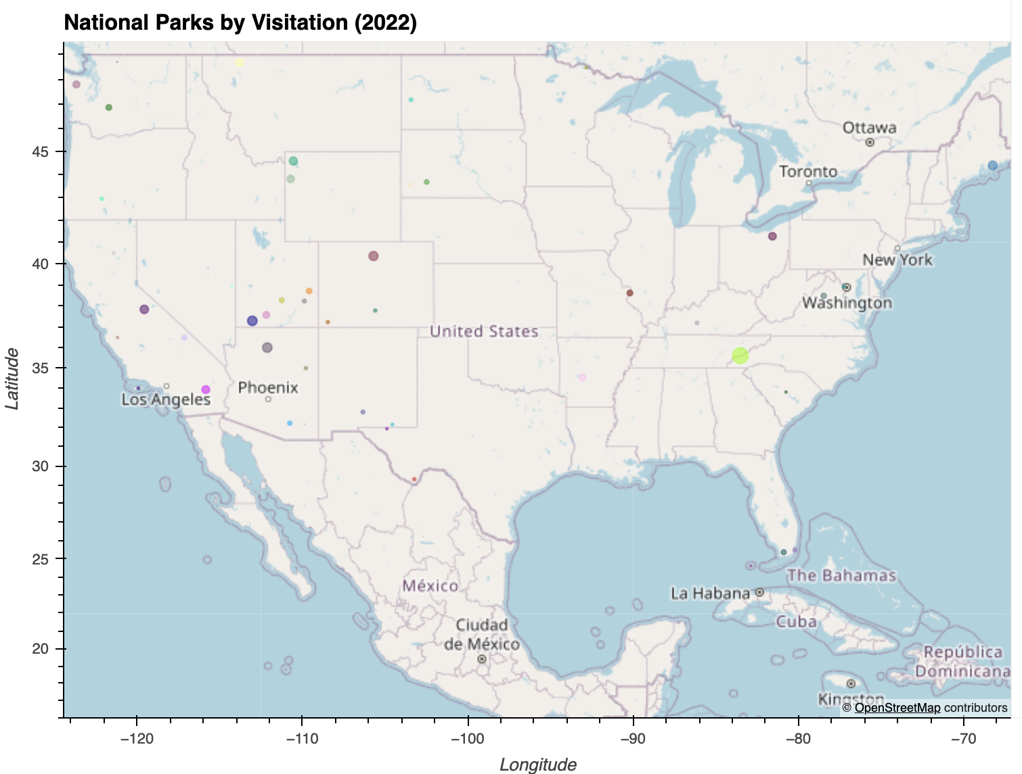
National Parks in Contiguous US
More national parks and visitation in the west
Most visited national park in NC and TN

Slide 14
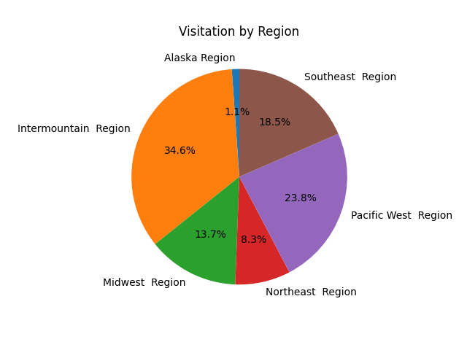
Visits by region
Distribution consistent with map
Less presence on the east coast

Slide 15
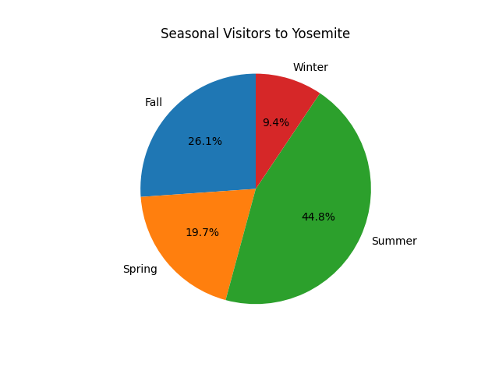
Seasonal Variance
Summer is the most popular time
Winter = low crowds, potential bad weather

Slide 16
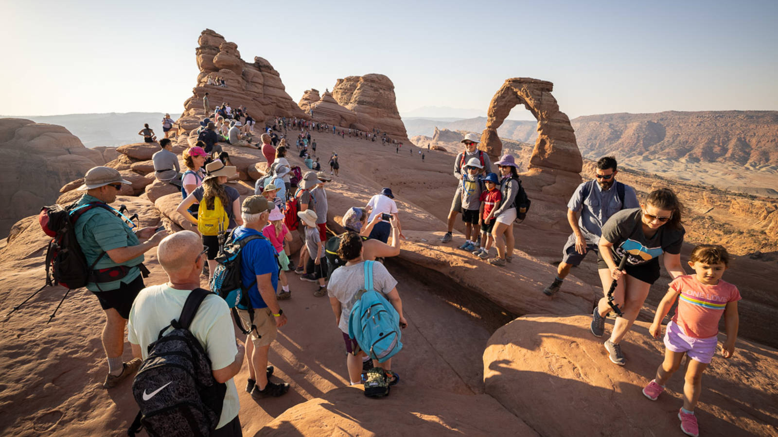
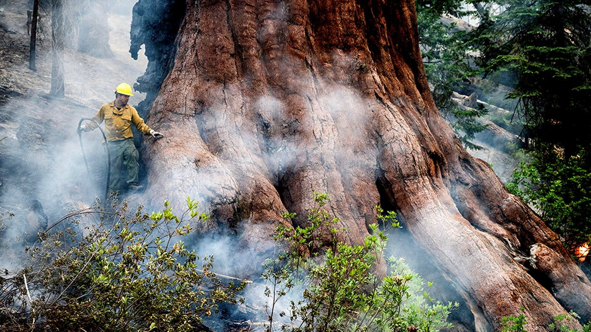
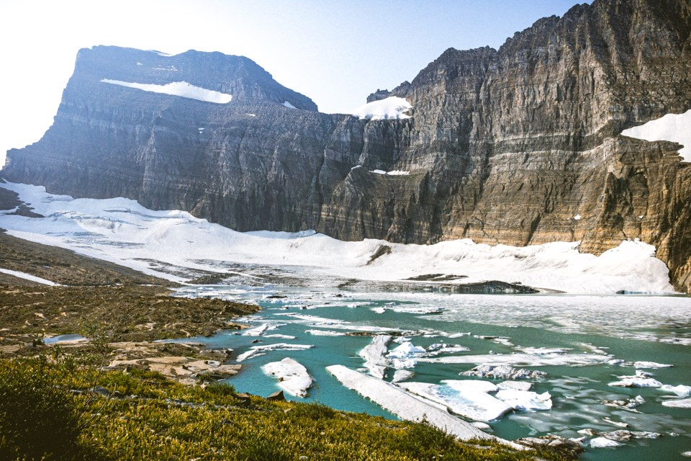
Where to go next
How can this growth be sustained?
What can be applied to protecting lands across the world?

